Slide 1
DeyGo
A Passenger Positioning System

Slide 2
What we’ll discuss
01
02
03
Introduction
Entity
Relationship
What database and why?
Describing the various entities in the system
Defining the relationships that exist between entities

Slide 3
01
02
03
Introduction
Entities
Relationships

Slide 4
01
02
03
Introduction
Entities
Relationships

Slide 5
User
5
1
4
2
3
Email
User_id
Current location
Name
Tel

Slide 6
Passenger
2
1
Passenger_id
User_id

Slide 7
Driver
2
1
driver_id
User_id
3
4
Taxi Number
rating

Slide 8
Transaction
5
1
4
2
3
passenger_id
transaction_id
driver_id
amount
status

Slide 9
Ride Request
1
6
driver_id
passenger_id
5
1
4
2
3
status
ride_id
time
destination
location

Slide 10
Location
2
1
longitude
location_id
3
latitude

Slide 11
Saved Location
2
1
user_id
location_id

Slide 12
01
02
03
Introduction
Entities
Relationships

Slide 13
Design Decisions
01
Passenger
Ride Request
Saved Location
02
04
01
03
05
User
Driver
Transaction
01
Location

Slide 14
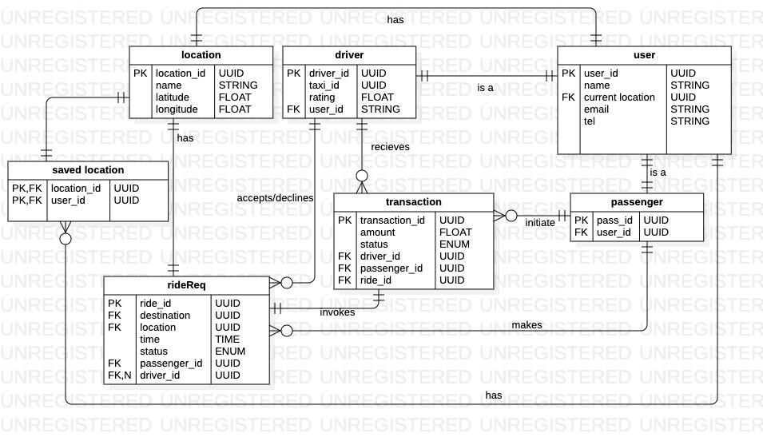
Relationships

Slide 15
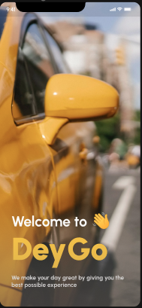
Dey Go
01
02
03
Book
Connect
Destination

Slide 16
?
Need a Taxi?
Just DeyGo
DeyGo

Slide 17
We have arrived our final Destination.
Thanks for listening!
A
B

